Slide 1

OGF20 Working Session 1 of 2
Reference Model Working Group
Co-Chairs -
Dr David Snelling, Fujitsu Labs
Paul Strong, eBay Research Labs
7th May 2007

Slide 2

Agenda
Session 1
  Purpose, Charter & Goals
  RM v1.5 Overview
  UML 2.0 For Component Model & Relationships
  Examples
Session 2
  UML 2.0 For Grid Component LifeCycle
  Life Cycle Examples

Slide 3
RM-WG Session 1
Purpose, Charter, Goals Recap

Slide 4
Purpose
Need a common language, glossary, taxonomy, ontology and formal model to describe Grids, what they are, how they are composed, managed etc.–
  Nouns
  Relationships
  Life-cycles
Basis for
  Interface design/specification
  Architecture
Unified context for many existing standards

Slide 5
Foundation
Build, extend and link existing efforts
  EGA Reference Model v1.5
  OGSA
  CDDLM
  Etc.

Slide 6
Sharp Focus
Global applicability but focus on manageability
First phases driven by imaginary deliverable – a data center configuration management service
  Store, update, query persistent and volatile state, properties and attributes of all managed entities, physical or logical
Later phases to focus on provisioning, monitoring and managing.

Slide 7
Pragmatic
Provide unifying context
Leverage existing standards or work wherever possible through reference/mapping–
  OGF - OGSA, CDDLM etc.
  Common Information Model (DMTF)
  SMI-S (SNIA)
  ITIL
  SID
  eTOMS
  DCML
  SML

Slide 8
Reference Model v2.0
Formal meta-model based on EGA Reference Model v1.5
Basic UML 2.0 representation
  Static Classes
  State Transitions
  Sequence Diagrams
Extensive text annotation

Slide 9
Reference Model v2.1
Mappings to and/or recommendations for existing and proposed OGF standards
  OGSA
  CDDLM
  Glue?
  BES
  JSDL

Slide 10
Reference Model v2.2
Mappings, references etc. to existing external standards –
  CIM
  SMI-S
  ITIL
  SID
  eTOMS
  DCML
  SML

Slide 11
RM-WG Session 1
EGA Reference Model v1.5 Recap

Slide 12
EGA Reference Model v1.5:
Classifying Grid Components
Biz Process/-Service
E-Bookstore
ERP Service
Online Bank
Virtualized
Platform
Web Server Farm
Clusters
Load Balanced Farms
Aggregations
Federation
Platform Instance
Database
Web Server
Application Server
LDAP
Virtualized
OE
Network
File systems -
NFS, CIFS
Virtualized OS
eg N1 Grid Containers, BSD Jails etc.
Load Balancers, Global IP in
clusters
OE
OS - eg AIX, HP/UX, Linux, Solaris, Windows etc.
File Systems
IP, TCP, UDP etc
Virtualized
Physical
LUNs,
Volumes
VMMs & Hypervisors
Hardware Partitions
VLANs
Physical
Disks, Array Controllers, SAN Switches
Servers,
Blades etc.
Switches, Routers etc..
Storage
Compute
Network
Notes:
Paul will remove shading from text

Slide 13
EGA Reference Model v1.5:
Representing Services As Graphs
More detailed drill down
E Bookstore
Persistent
Storage
Tier
Business
Logic
Tier
Presentation
Tier
Database
Cluster
Application
Server
Cluster
Web
Server
Farm
Database
Instance
Database
Instance
Application
Server
Instance
App Server
Load
Balancer
App
Server
Firewall
Web
Server
Instance
Web Server
Load
Balancer
Web
Server
Firewall
Database
Storage
Database
Transaction
Log Storage
OS
Container
Database
Media
OS Instance
Patches
OS Instance
OS Instance
OS Instance
Hardware
Partition
OS Media
Server
Boot
Disk/LUN
Server
Server
Load
Balancer
Firewall
Server
Load
Balancer
Firewall

Slide 14
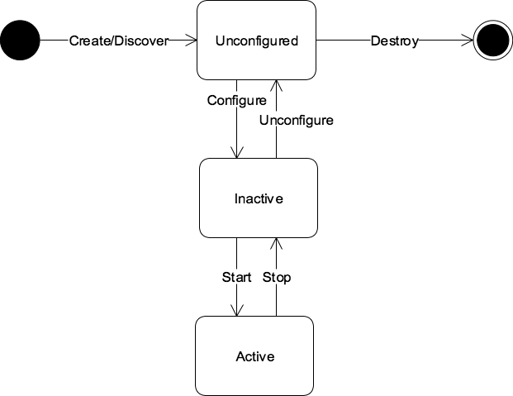
EGA Reference Model v1.5:
Grid Component Life Cycle
NOTE – Some Of The Terms Change In The OGF Version.
See Session 2
Provision
Decommission
Manage

Slide 15
EGA Reference Model v1.5:
Provisioning By Walking The DAG
ApplyVerb {ProvisionGridComponent}
Database
Instance
Database
Media
1
Database
Binary Storage
2
OS Container
3
Database
Transaction
Log Storage
4
Database
Storage
5
OS Instance
3.1
OS
Patches
3.2
OS Media
3.1.1
Server
3.1.2
Boot Disk/LUN
3.1.3

Slide 16
EGA Reference Model v1.5:
Provisioning By Walking The DAG
ApplyVerb {ProvisionGridComponent}
Database
Instance
Database
Media
1
Database
Binary Storage
2
OS Container
3
Database
Transaction
Log Storage
4
Database
Storage
5
OS Instance
3.1
OS
Patches
3.2
From leaf nodes up
OS Media
3.1.1
Server
3.1.2
Boot Disk/LUN
3.1.3
From left to right

Slide 17
EGA Reference Model v1.5:
The Grid Management Entity (GME)
  Manages the collection of Grid Components
  Manages the relationships between them
  Manages their life cycle
  May be realized
    Through people and process
    Through automated tools
    A combination of the above
  Provides the context for understanding the key problems associated with managing Grid Components today
  Is the Macro-Actor in all use cases

Slide 18
EGA Reference Model v1.5:
Role of Grid Management Entity
Vendor
Support
Enterprise
Bugs etc.
Notifications,
Patches etc.
Policy
Accounting &
Billing
GME
Other GMEs
Managing includes
Provisioning
Discovery
Configuration
Activation
Controlling
State
Performance
Scaling
Availability
Security
Decommissioning
Manage
Monitor
Monitoring includes
State
Performance
Scaling
Availability
Security
Accounting
Grid
Component

Slide 19
EGA Reference Model v1.5:
GME and Grid Component Life Cycle
GME
Discover,
Control,
Monitor,
Notify

Slide 20
EGA Reference Model v1.5:
GME and Service Level Management
Vendor
Support
Enterprise
Bugs etc.
Notifications,
Patches etc.
Policy
Accounting &
Billing
GME
Assigns/Provisions
Reconciled
Resources
(other
Grid Components)
Metrics
Manage
Monitor
Grid
Component
Consumed
Generates

Slide 21
EGA Reference Model v1.5:
Grid Management Entity
GME
Distributed
Hierarchical
Persistent
Storage
Tier
Embedded GME
Functionality In
Cluster Management
Framework
Policy Delegation
App Server
Cluster
App Server
Instance
App Server
Instance

Slide 22
EGA Reference Model v1.5:
GME Delegated Policy and SLM
Vendor
Support
Enterprise
Bugs etc.
Notifications
Patches etc.
Business
Policy
Accounting
& Billing
Logical
GME
Data Center
GME
Component
Derived
Policy
Accounting
& Billing
Provision
Bookstore
GME
Component
Manage
Electronic
Bookstore
Grid
Component
Monitor
Derived
Policy
Accounting
& Billing
Provision
Database
Cluster
GME
Component
Manage
Database
Cluster
Grid
Component
Application Server
Cluster
Grid
Component
Monitor

Slide 23
EGA Reference Model v1.5:
GME Delegated Policy & SLM
Vendor
Support
Enterprise
Bugs etc.
Notifications
Patches etc.
Business
Policy
Accounting
& Billing
Logical
GME
Data Center
GME
Component
Derived
Policy
Accounting
& Billing
Provision
Bookstore
SLM GME
Component
Manage
Electronic
Bookstore
Grid
Component
Monitor
Derived
Policy
Accounting
& Billing
Provision
Database
Cluster
SLM GME
Component
Manage
Database
Cluster
Grid
Component
Application Server
Cluster
Grid
Component
Monitor
Database Cluster Product

Slide 24
EGA Reference Model v1.5:
GME Functional Breakdown
Vendor
Support
Enterprise
Bugs etc.
Policy
Accounting
& Billing
Provisioning/-
Decommissioning_x0016_
Notifications
Patches etc.
Business
Policy
Accounting
& Billing
Service
Level
Management
Logical
GME
Data Center
GME
Component
Security _x0003__x0016_
Orchestration
Control_x0003__x0016_
Derived
Policy
Accounting
& Billing
Provision
Performance
Management
Availability
Management _x0003__x0016_
Bookstore
GME
Component
Manage
Electronic
Bookstore
Grid
Component
Monitor
Monitor
Derived
Policy
Accounting
& Billing
Provision
Database
Cluster
GME
Component
Manage
Database
Cluster
Grid
Component
Application Server
Cluster
Grid
Component
Monitor

Slide 25
EGA Reference Model v1.5:
GME Functional Breakdown
Vendor
Support
Enterprise
Other GMEs
Bugs etc.
Accounting &
Billing
Notifications,
Patches etc.
Policy
Logical
GME
Enterprise
Grid
GME
Database
Instance
GME
Database
Instance
Database
Media
GME
Database
Binary Storage
GME
OS Container
GME
Database
Tx Log Storage
GME
Database
Storage
GME
Database
Media
Database
Binary Storage
OS Container
Database
Transaction
Log Storage
Database
Storage
OS Instance
GME
OS
Patches
GME
OS Instance
OS
Patches
OS Media
GME
Server
GME
Boot
Disk/LUN
GME
OS Media
Server
Boot
Disk/LUN

Slide 26
RM-WG Session 1
Component Model

Slide 27
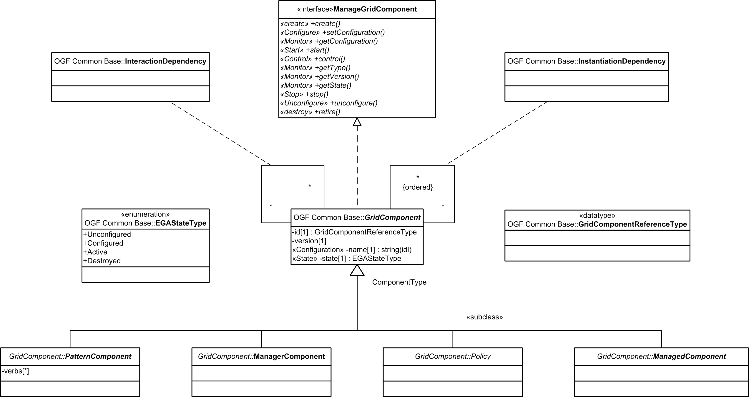
OGF RM v2.0a DRAFT
Core Class Hierarchy & Relationships

Slide 28
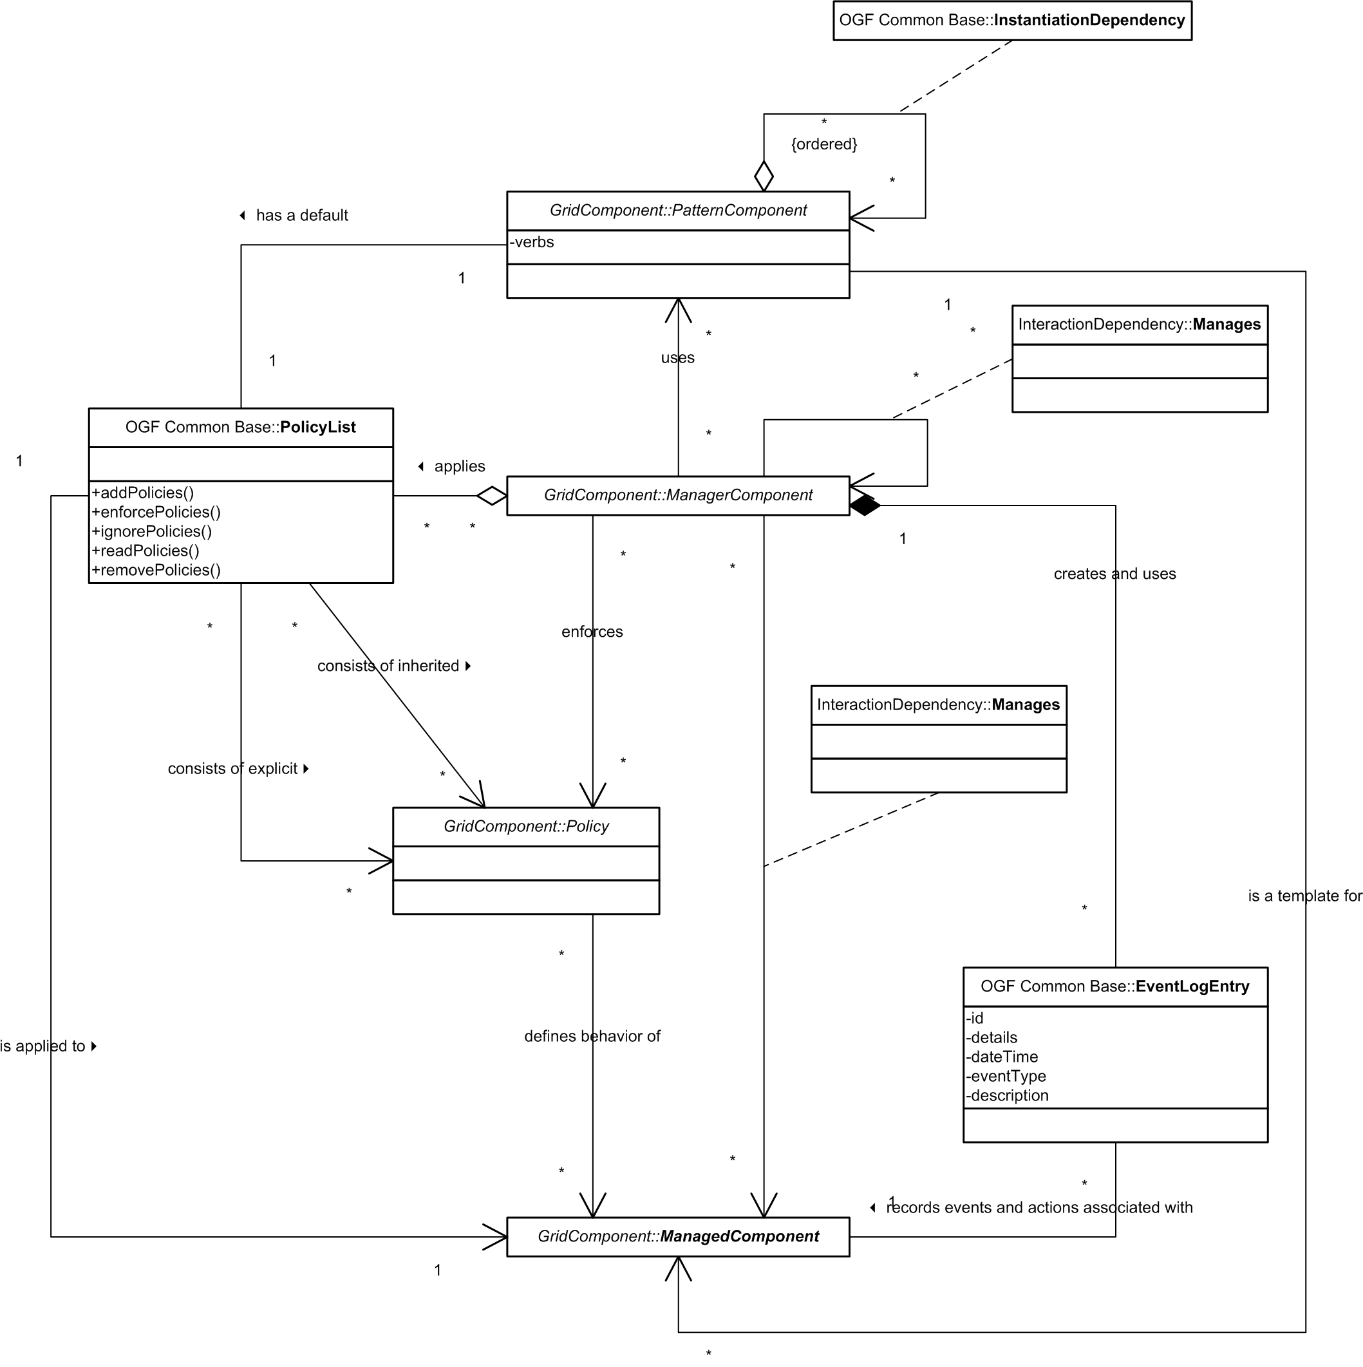
OGF RM v2.0a DRAFT
Core Top Level Class Relationships

Slide 29
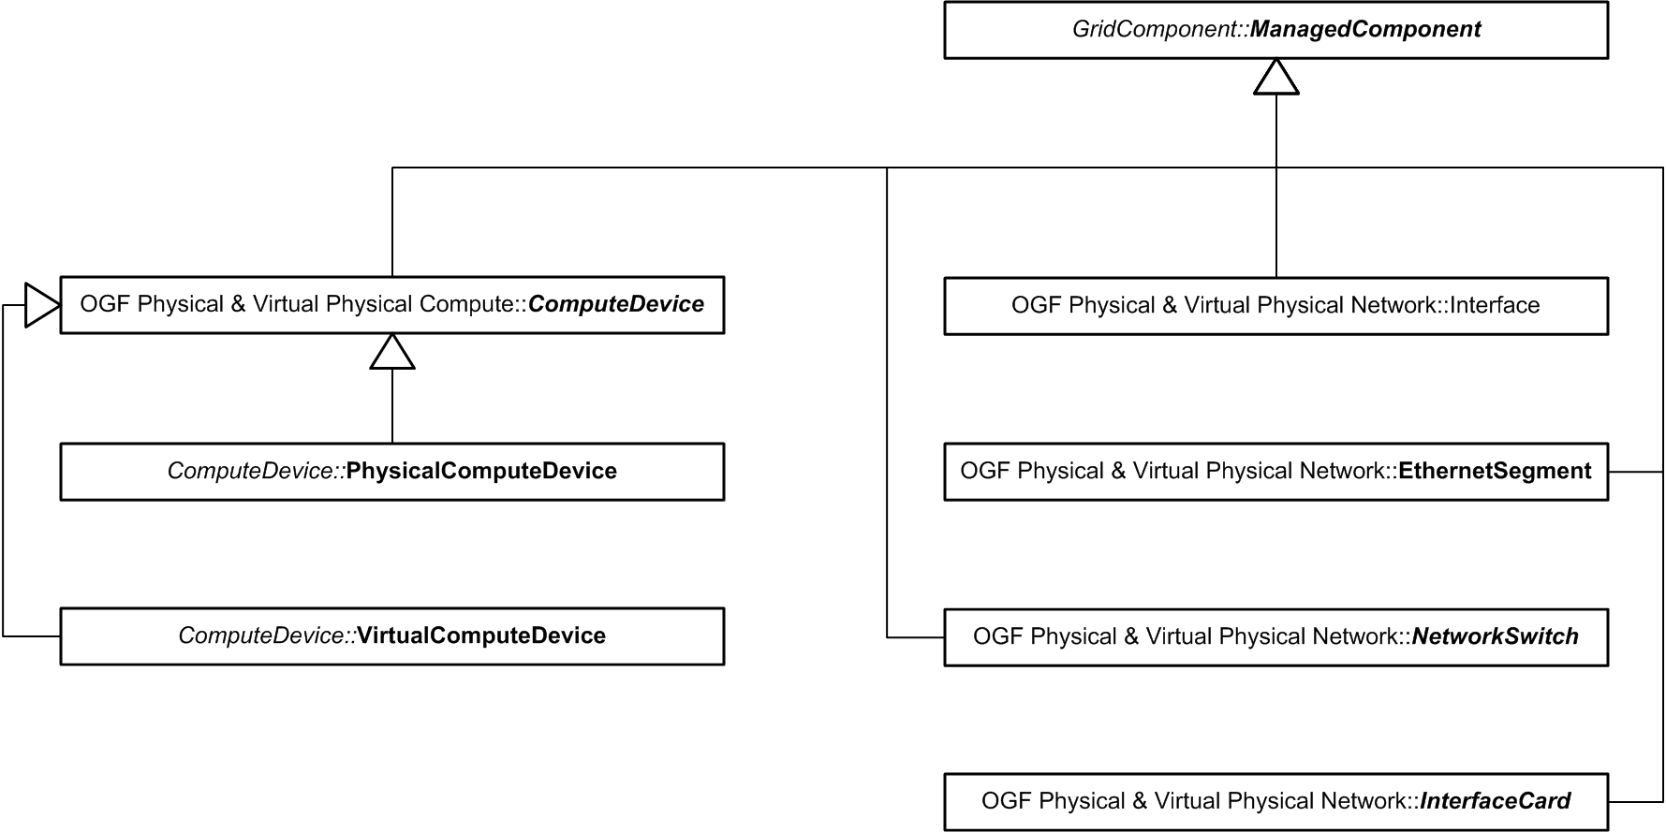
OGF RM v2.0a DRAFT
Physical & Virtual Physical Devices (excl. Storage)

Slide 30
RM-WG Session 1
Component Model Examples

Slide 31
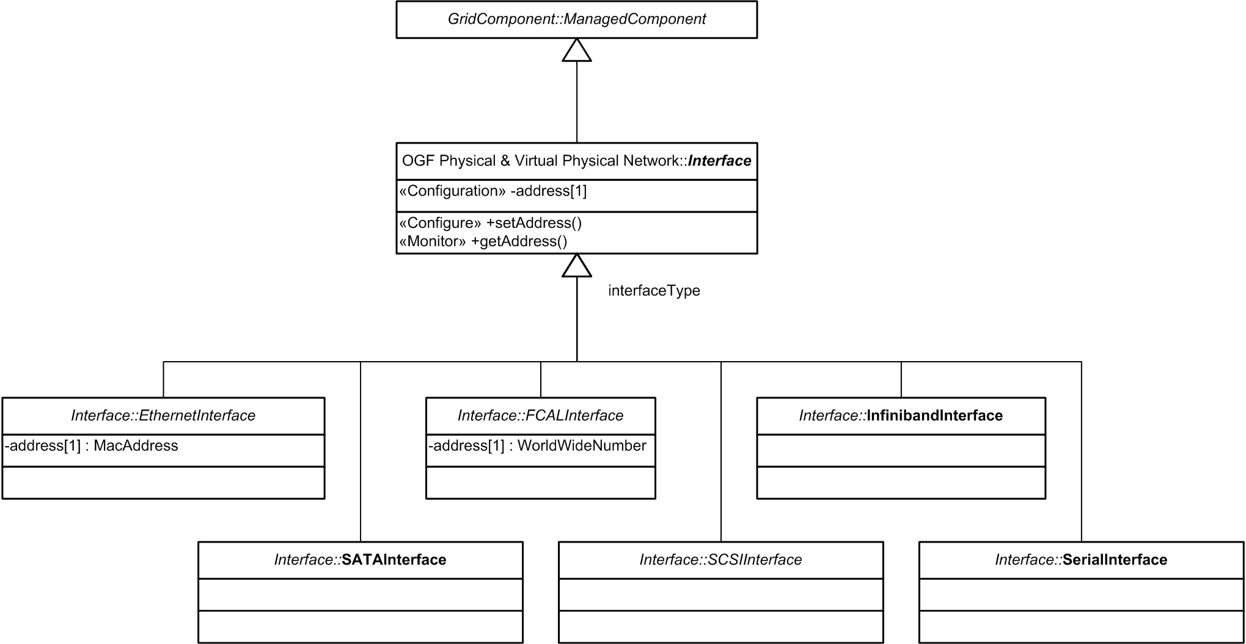
OGF RM v2.0a DRAFT
Example - Interfaces

Slide 32
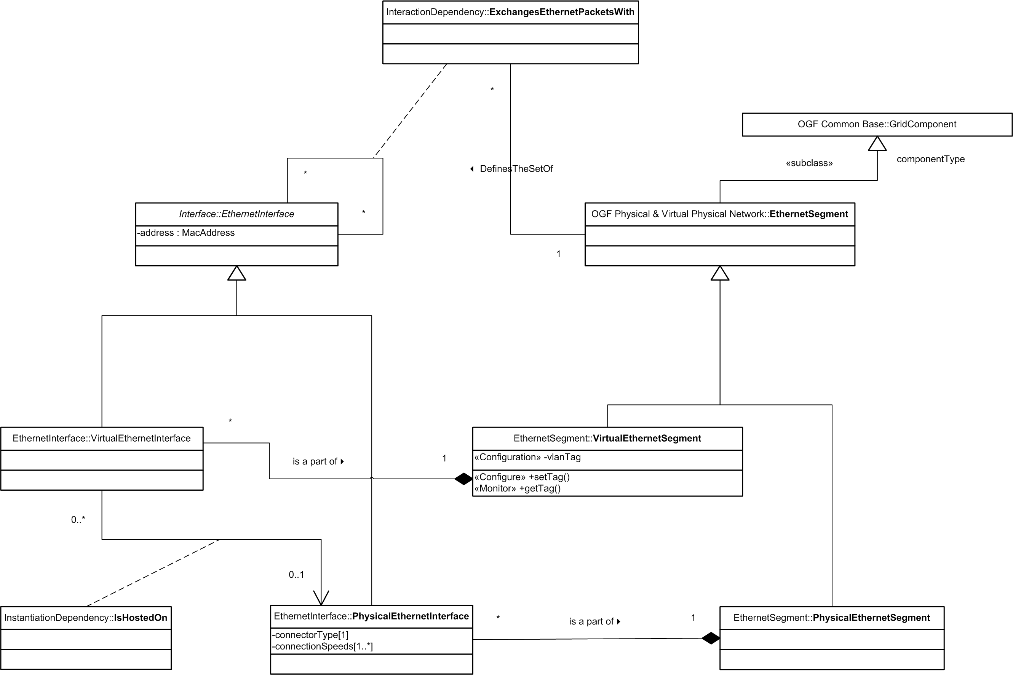
OGF RM v2.0a DRAFT
Example – Ethernet Networking

Slide 33
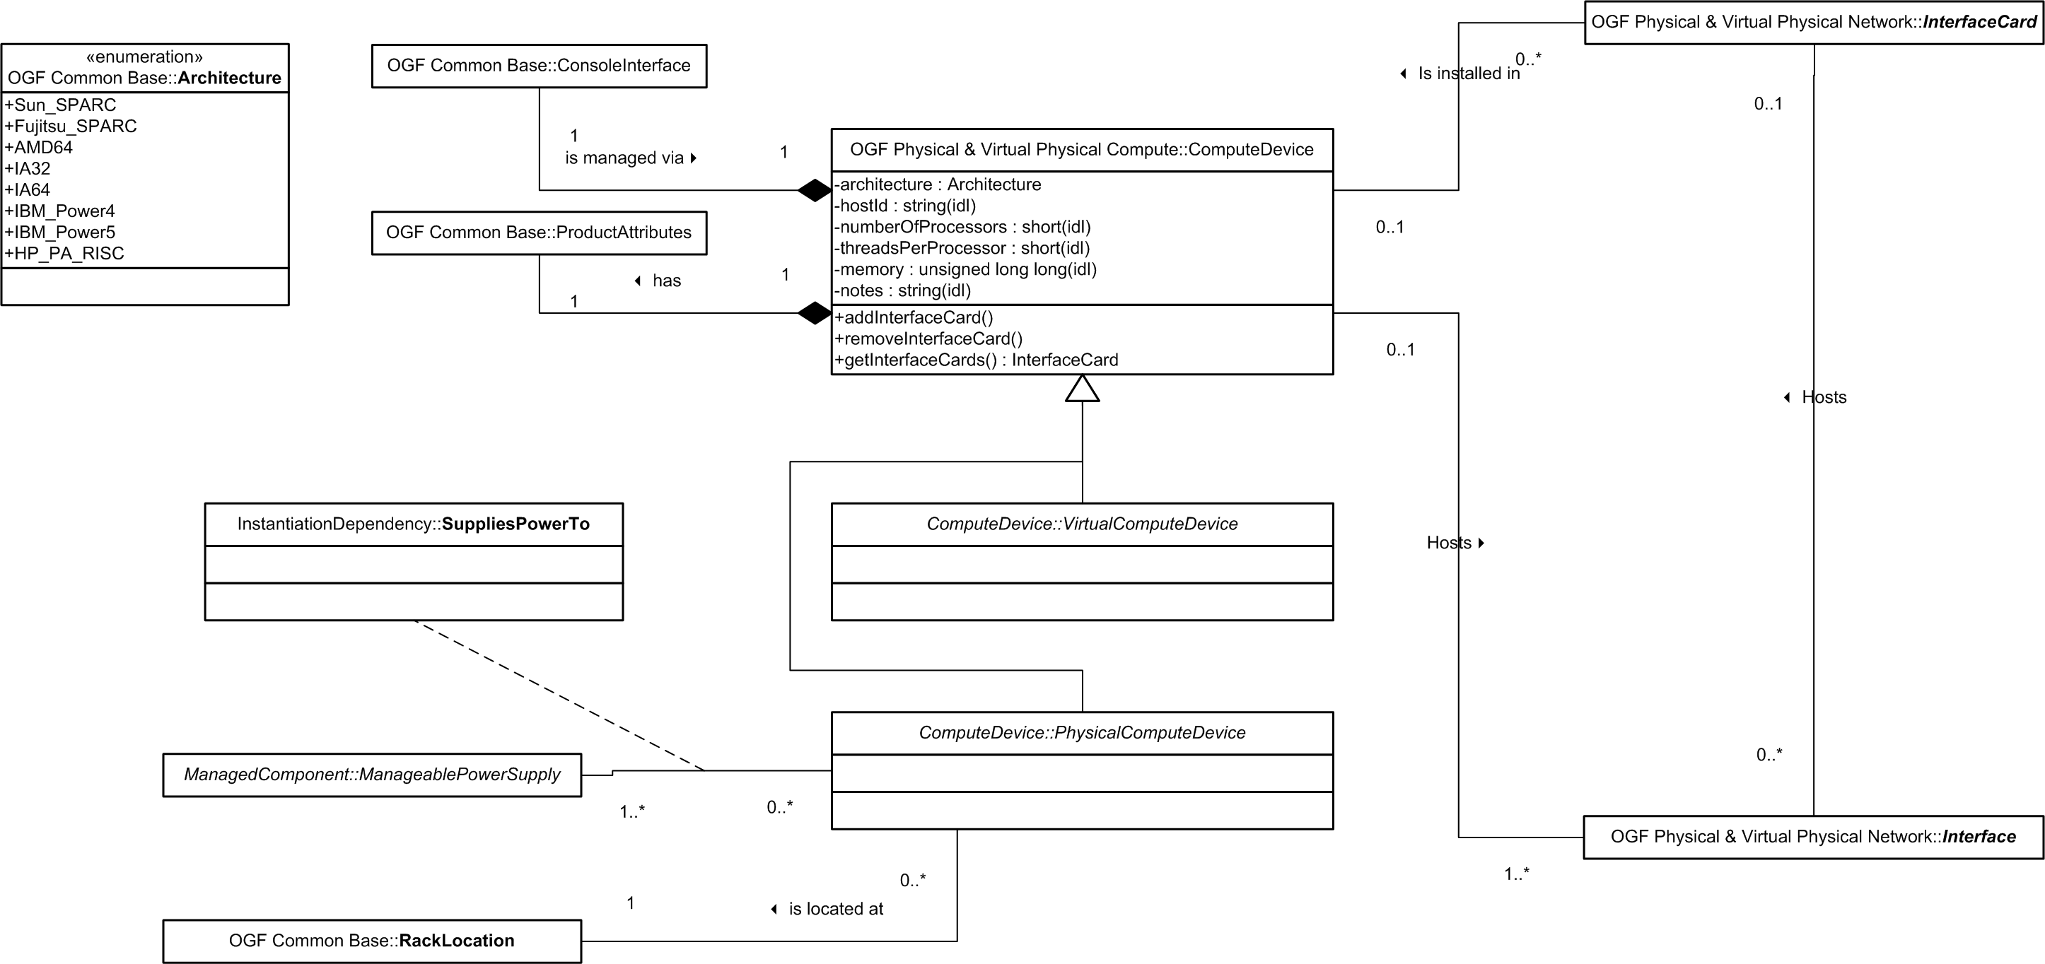
OGF RM v2.0a DRAFT
Example – Compute Devices

Slide 34
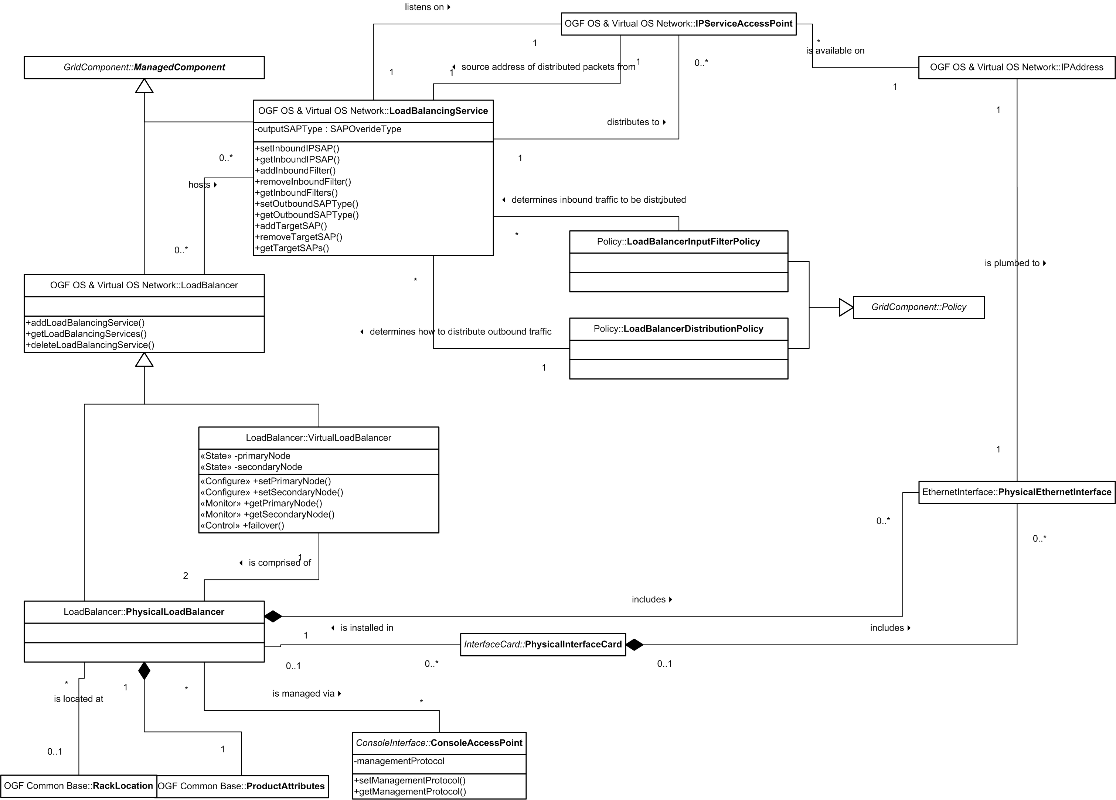
OGF RM v2.0a DRAFT
Example – Load Balancers & Load Balancing Services

Slide 35
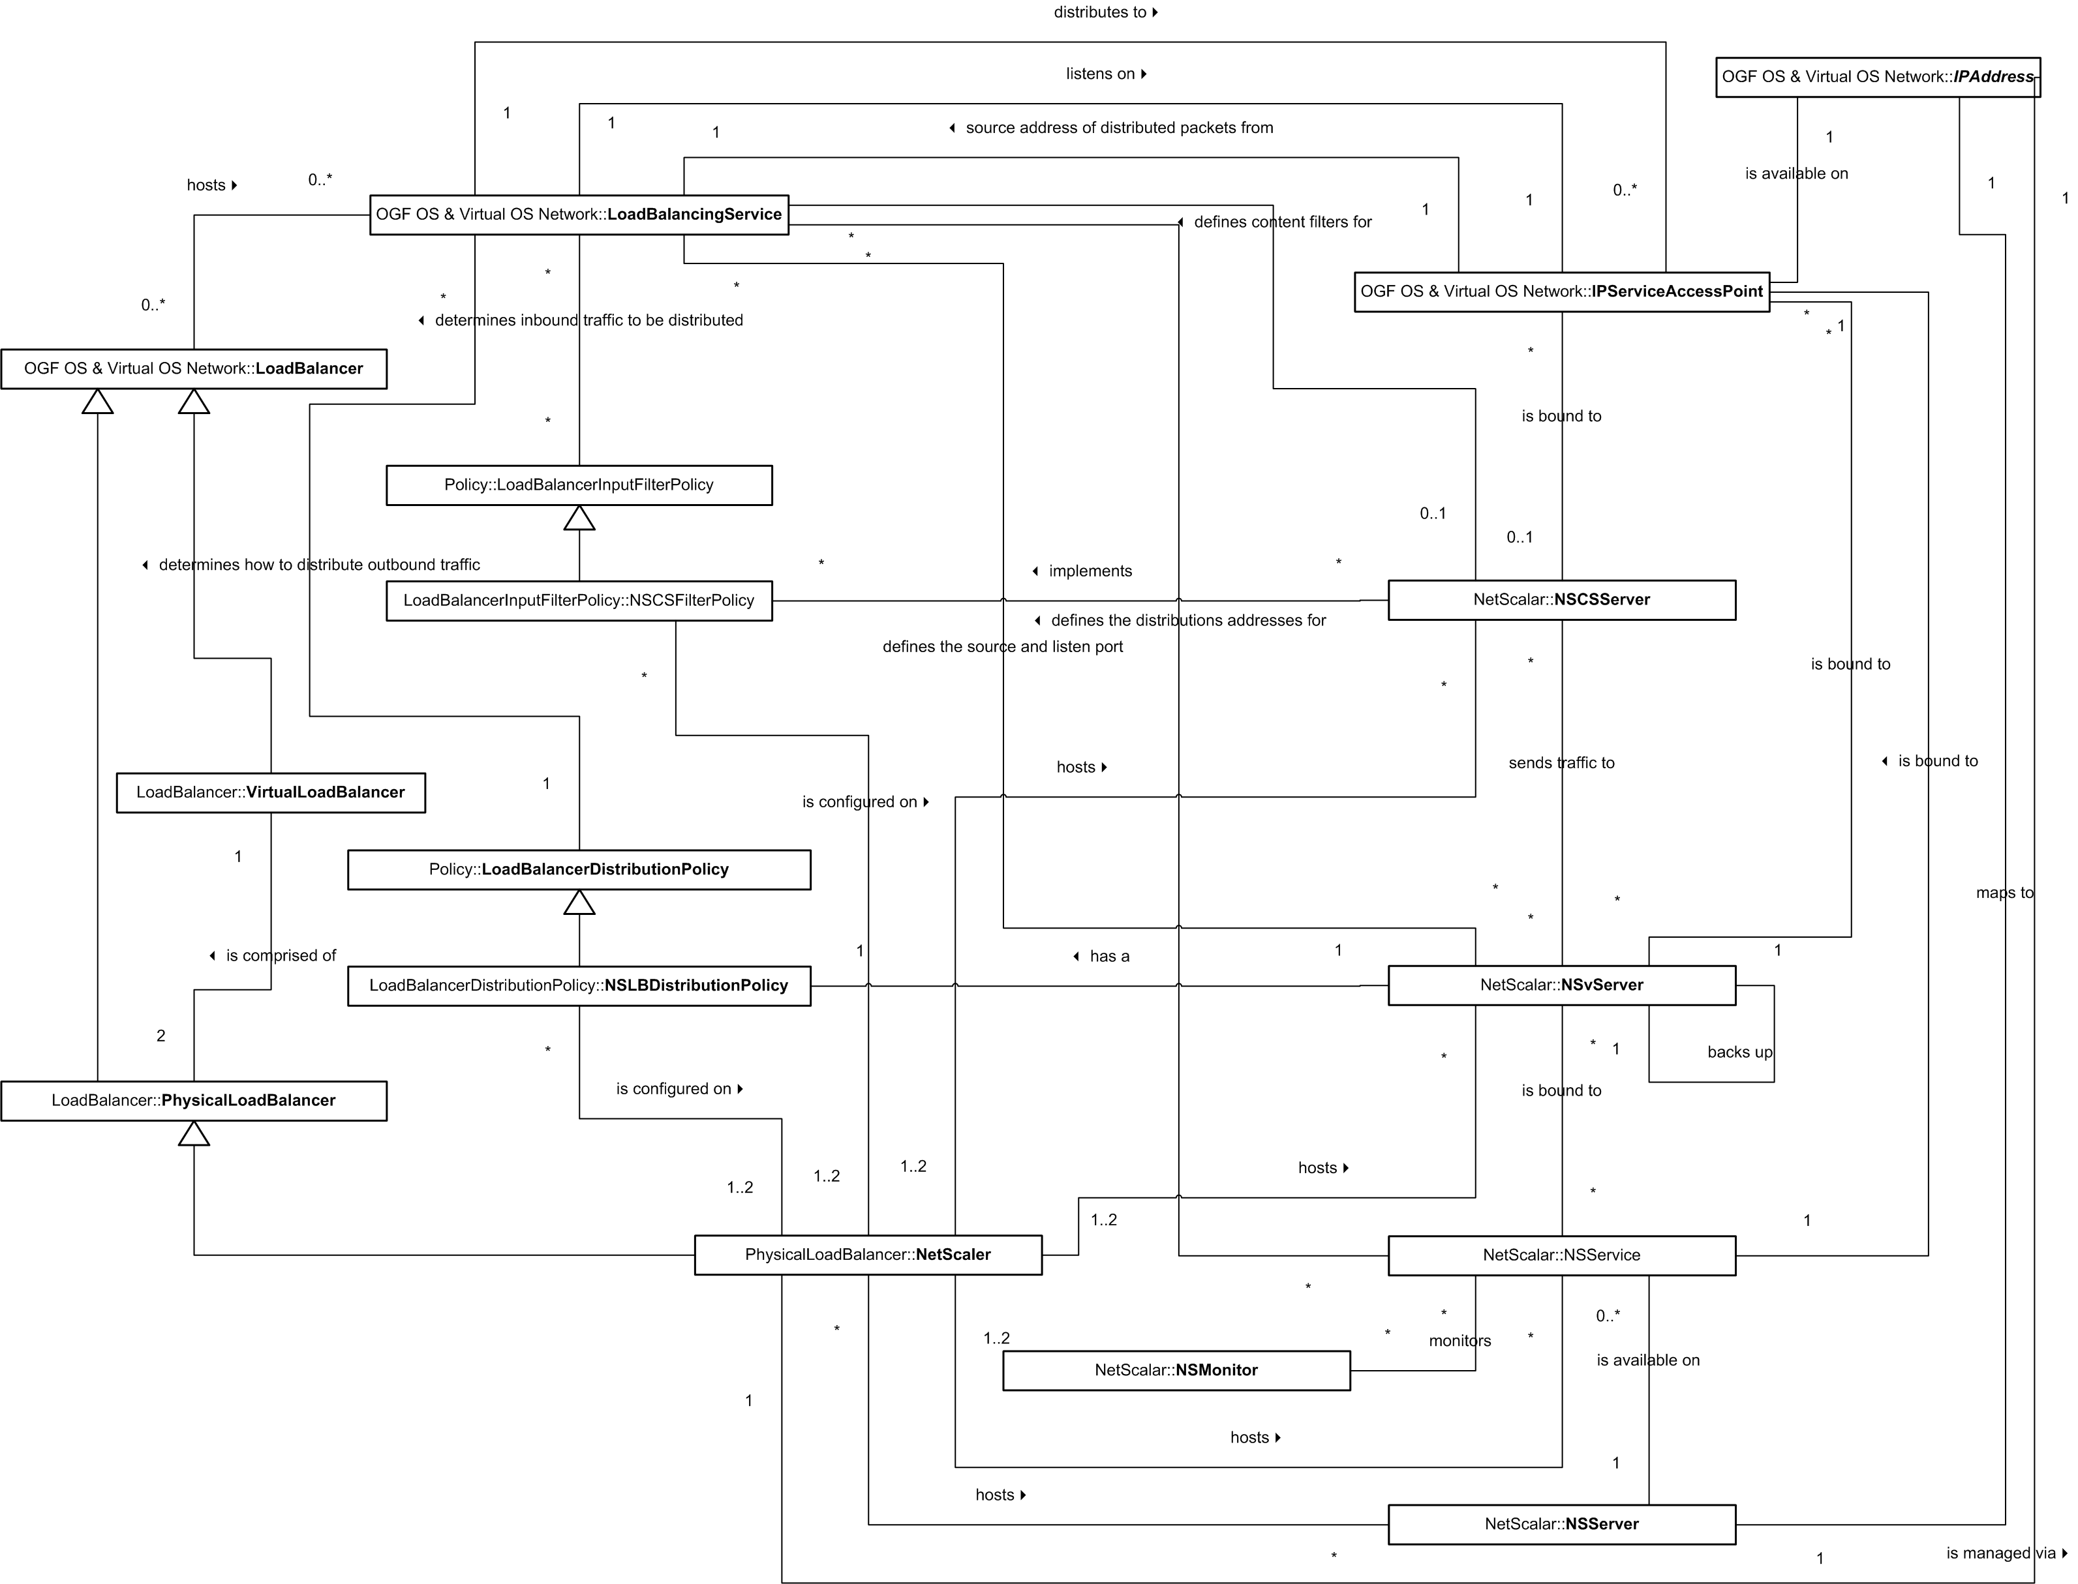
OGF RM v2.0a DRAFT
Example – Mapping To A Vendor

Slide 36
Session 2
Life Cycles & State Transitions

Slide 37
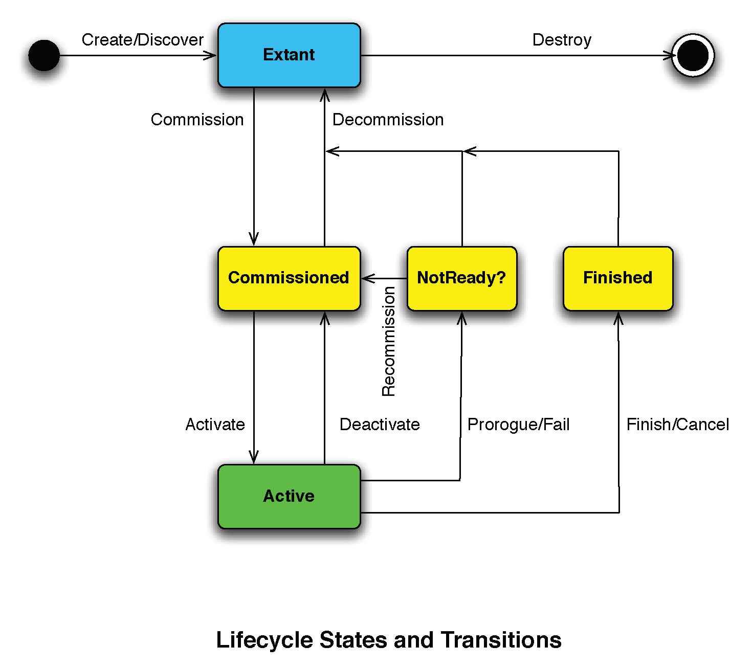
Life Cycle
Challenge To Original

Slide 38
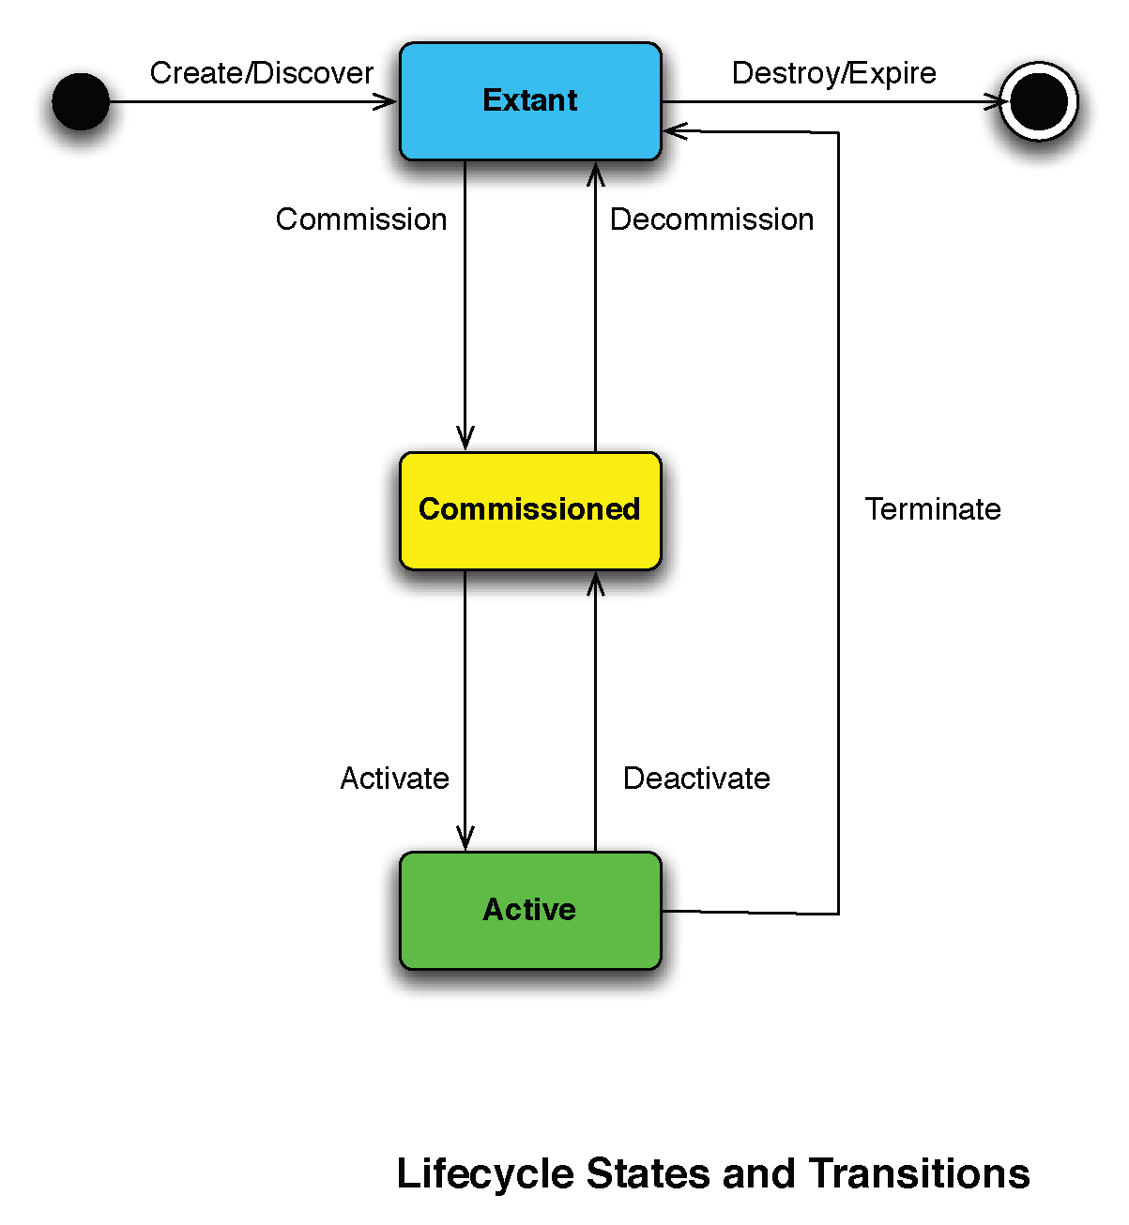
Life Cycle
Resolving Through Additional Transition

Slide 39
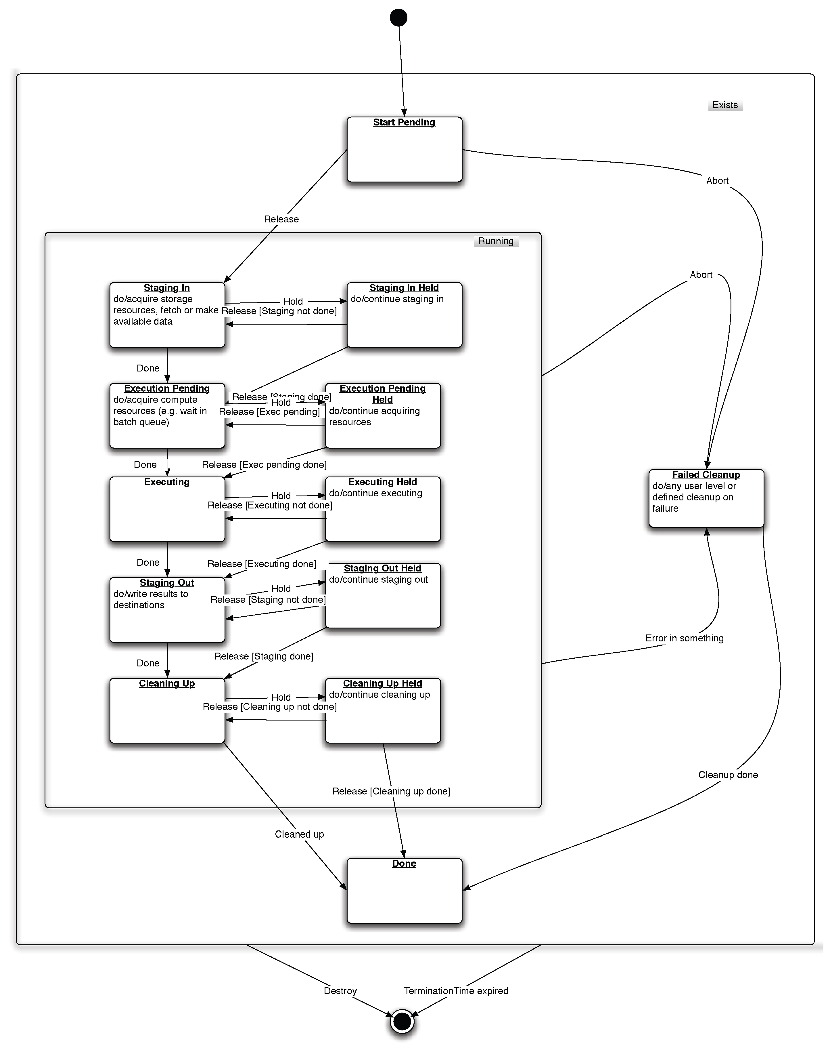
Life Cycle Examples -
ESI Life Cycle

Slide 40
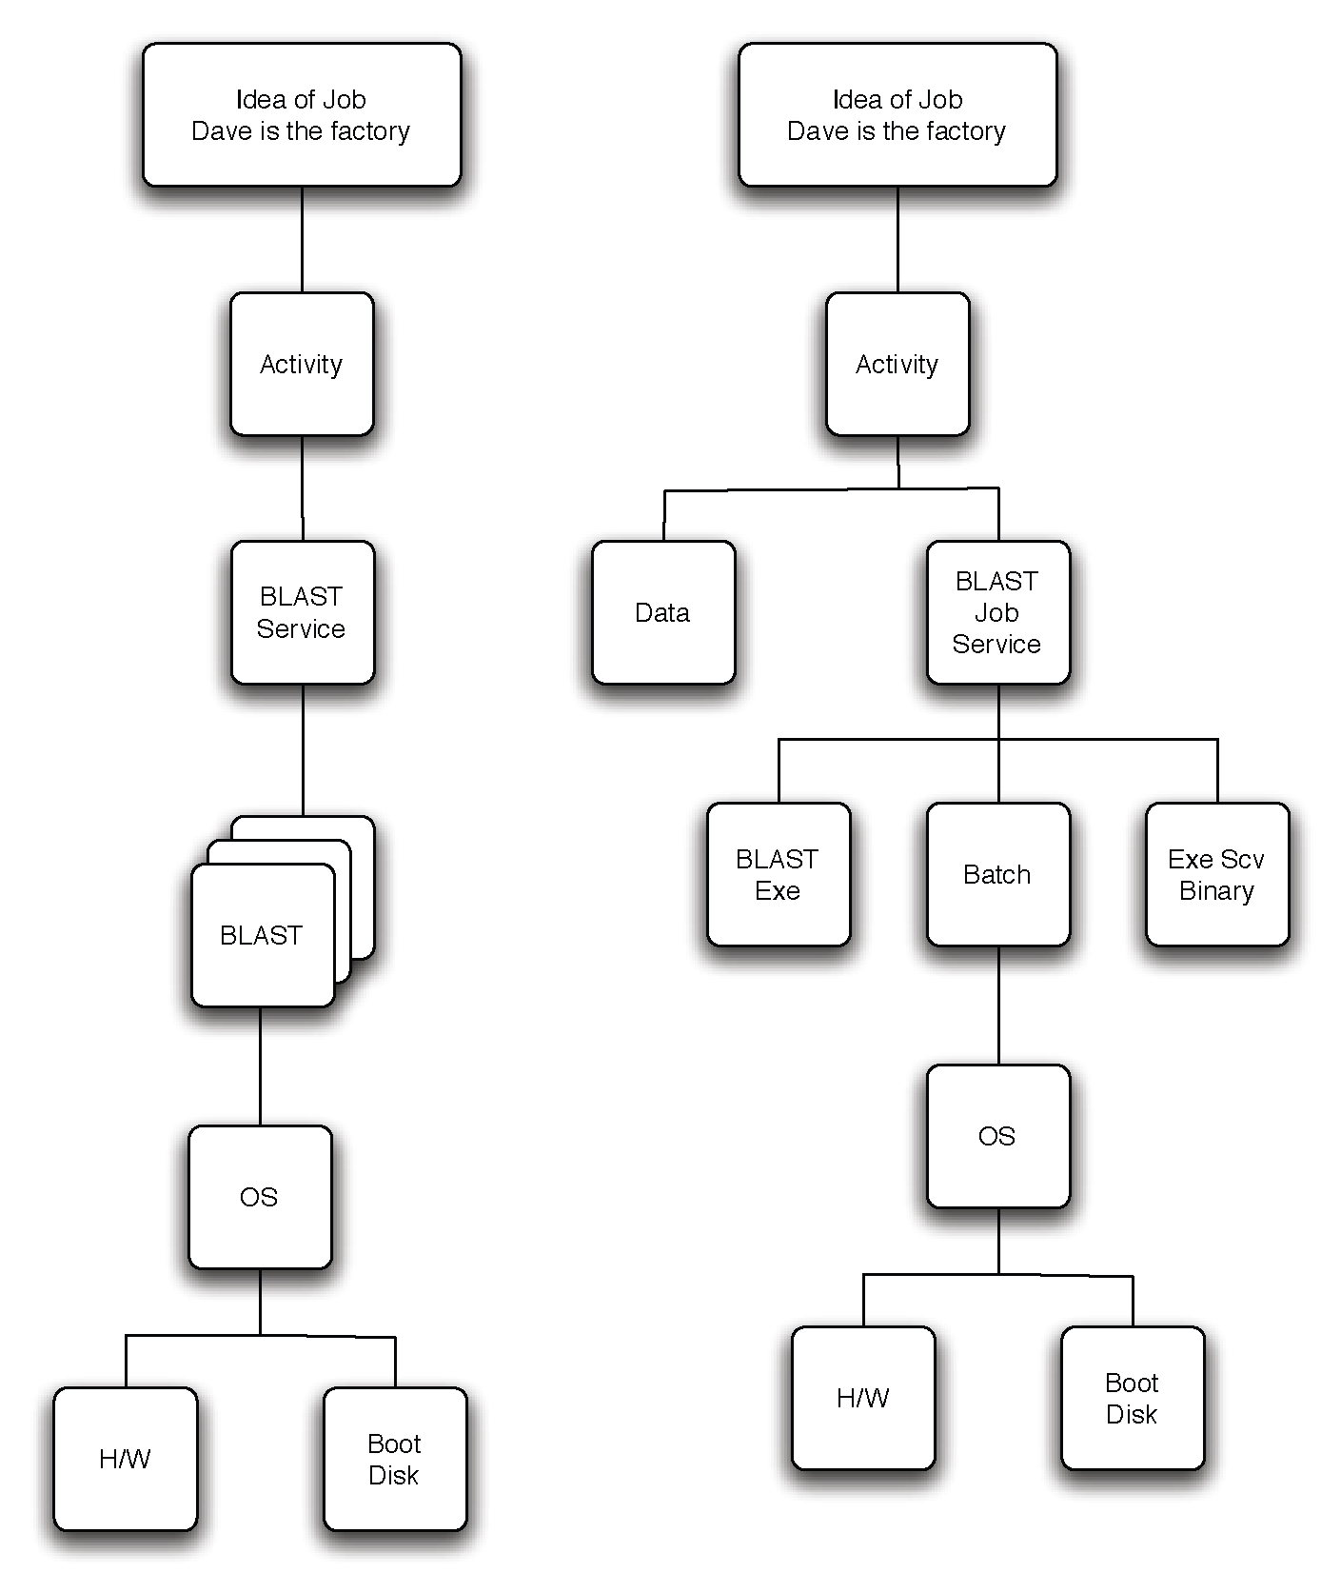
Life Cycle Examples -
JSDL Life Cycle – 2 Options/Realizations

Slide 41
Life Cycle Examples -
Book Store 1
More detailed drill down
E Bookstore
Persistent
Storage
Tier
Business
Logic
Tier
Presentation
Tier
Database
Cluster
Application
Server
Cluster
Web
Server
Farm
Database
Instance
Database
Instance
Application
Server
Instance
App Server
Load
Balancer
App
Server
Firewall
Web
Server
Instance
Web Server
Load
Balancer
Web
Server
Firewall
Database
Storage
Database
Transaction
Log Storage
OS
Container
Database
Media
OS Instance
Patches
OS Instance
OS Instance
OS Instance
Hardware
Partition
OS Media
Server
Boot
Disk/LUN
Server
Server
Load
Balancer
Firewall
Server
Load
Balancer
Firewall

Slide 42
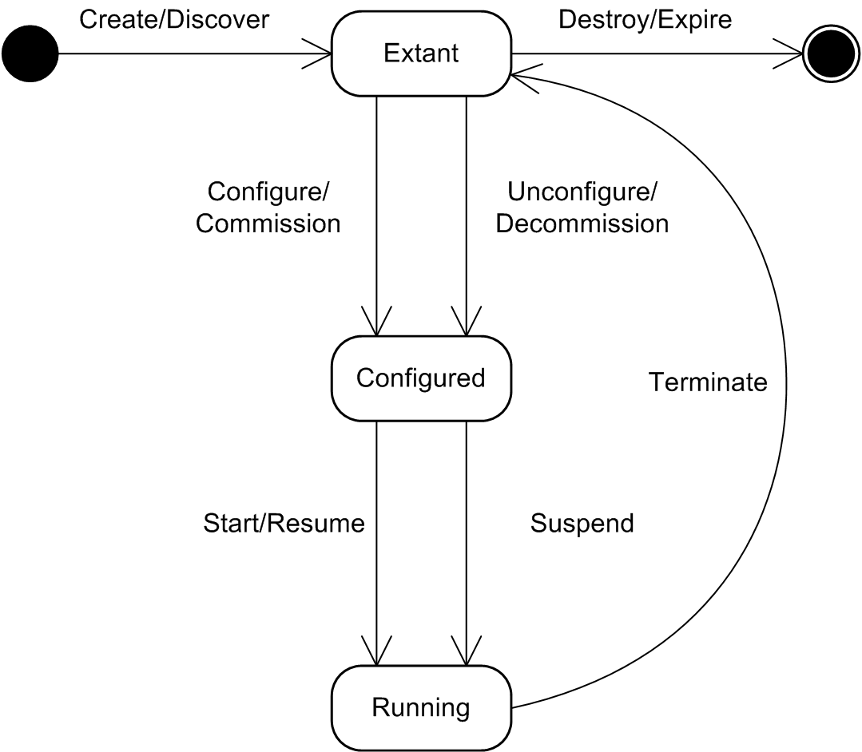
Book Store Life Cycle–
Physical Compute Device (Server)
Extant
  Server is manageable
Configured
  HBAs installed etc.
  LOM Configured
Running
  Powered Up

Slide 43
Book Store Life Cycle–
Virtual Machine Monitor
Extant
  VMM logically exists in GME
Configured
  Software installed on physical compute device
Running
  Started – a Virtual Compute Device can be created

Slide 44
Book Store Life Cycle–
Virtual Compute Device (Virtual Server)
Extant
  Virtual Server exists as a managed entity, the VMM knows about it
Configured
  Fully configured and ready to run – e.g. disks and networking mapped
Running
  Started. NB - The transition may not exist independently from booting the hosted OS depending on implementation

Slide 45
Book Store Life Cycle–
Operating System
Extant
  It is manageable, i.e. an instance exists in the management reposit.ory..
Configured
  Fully configured and ready to boot. NB late binding boot parameters may be mean we fall through this state.
Running
  Started. NB - The transition may not exist independently from booting the hosted OS

Slide 46
Full Copyright Notice
Copyright (C) Open Grid Forum (2007). All Rights Reserved.
This document and translations of it may be copied and furnished to others, and derivative works that comment on or otherwise explain it or assist in its implementation may be prepared, copied, published and distributed, in whole or in part, without restriction of any kind, provided that the above copyright notice and this paragraph are included on all such copies and derivative works.
The limited permissions granted above are perpetual and will not be revoked by the OGF or its successors or assignees.
Notes:
OGF Full Copyright Notice if necessary

